Slide 1
Conduct & Responsibility
International Rating Certificate

Slide 2
The Measurer’s Role
To report the facts
Be part of a team of race officials, whether that is either;
At an event,
Or in the boat yard
At an event, we would behave in a certain way – we would not want to have negative comments about our conduct from other race officials
When we are on our own, in a yard, we have to behave in the same way – still with integrity and lack of bias.
Wherever this is, we are still part of a wider team, we all need to apply the rules fairly and consistently.

Slide 3
Hats
We all have hats;
Teams have their team hats
Remember that they may be feeling pretty stressed – they want the best result for their hard work.
We have our IRC Measurer / wider race official hat
We can feel stressed to, especially if this is a new experience – we want to do a good job, to maintain a pure, level playing field, to be seen to be effective, do a good job, not create problems
Ultimately, everyone wants to have a positive experience.

Slide 4
Impartial and courteous
The measurer is working for the Rule Authority, on behalf of an owner, but also representing the rest of the fleet, making sure that no one has a unfair advantage.
Be consistent.
Can you sail on a boat that you weighed, or measured the sails for?

Slide 5
Impartial and courteous
Do not offer advice to an owner/competitor
There may be time when an owner will ask for advice for getting a “better” measurement or how they can get a better rating. Opinions on how to make a boat rate better under IRC are often anectodatal due to the undisclosed nature of the rating calculation. As a measurer you should not be doing this anyway

Slide 6
Conflict of interests
World Sailing regulation 34 states;
34. CONFLICT OF INTEREST
34.1 A conflict of interest exists when a World Sailing Race Official has, or reasonably appears to have, a personal or financial interest which could affect the official’s ability to be impartial.
34.2 When a World Sailing Race Official is invited to serve at a regatta he/she shall consult the “Race Officials Committee Guidelines for Assessing a Conflict of Interest for Race Officials” as published on the World Sailing website and act in accordance with these guidelines, which may be to decline the invitation.
34.3 When the World Sailing Race Official has any doubt, on the action to take he/she shall promptly consult World Sailing, prior to accepting the invitation and be bound by its decision.
34.4 When, at an event, a World Sailing Race Official becomes aware of a conflict of interest, the official he/she shall disclose the potential conflict to the International Jury which shall take appropriate action in accordance with the “Race Officials Committee Guidelines for Assessing a Conflict of Interest for Race Officials” as published on the World Sailing website.
34.5 All World Sailing Race Officials appointed to the events listed in Regulations 25.8.10 and 25.8.11 shall declare any conflict of interest to the Chief Executive Officer and update their declaration when relevant. A conflict of interest declaration from a race official shall include the information necessary to assess in accordance with the “Race Officials Committee Guidelines for Assessing A Conflict of Interest for Race Officials” whether the race official in question has a conflict of interest in relation to a specific event.
34.6 The Race Officials Committee shall develop and maintain a register of conflict of interest declarations from World Sailing Race Officials. The information, contents and administration of the register shall be described by the Race Officials Committee, approved by the Board and be published on the World Sailing website.

Slide 7
Conflict of Interests
This equally applies to measurers conducting certification measurement and if in doubt contact the rating office
If you think there is a problem with you, or with someone else, seek clarification;
World Sailing are also interested in Conflict of Interest - contact
raceofficials@isaf.co.uk

Slide 8
Conflict of Interests
Not a good idea to hang out with one set of competitors.
Don’t unnecessarily favour, or be seen to favour one competitor over another, even if outside your discipline.

Slide 9
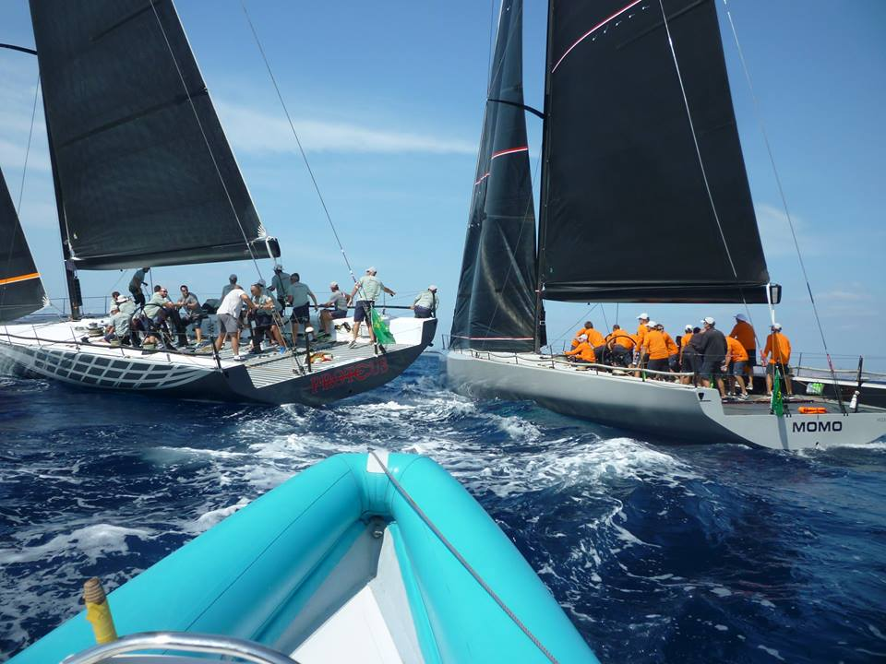
WS – Social Media
To post? Or not to post?
Don’t divulge information about one boat that could be useful to another.
If you want to help publicise an event, or a class, and as long as the hierarchy of the class agree, that’s great!

Slide 10
Discussion / questions.

